Slide 1


Presentation Title Screen
Damian Mulvena
2025-03-06

Slide 2
Outline
Executive Summary
Introduction
Methodology
Results
Conclusions
Appendix

Slide 3
Executive Summary
Methodologies
Public data concerning SpaceX launches, components, reuse and reliability was captured
This was examined through graphic and query analysis, for insight into important factors
Finally, the data was transformed into Machine Learning predictive models to identify whether rocket reuse could be feasible
Summary
Factors were examined, such as Launch Sites, intended Orbits, Payload mass and Booster version.
Progress over time was also examined, whether as “Flight No.” or Yearly-trend, where it could be seen that recovery rates increased over time
Outcome
There is every expectation that SpaceY will be able to reuse the first-stage booster rockets, reducing the launch costs and allowing successful competition with SpaceX

Slide 4
Introduction
As a data scientist in SpaceY, my objective is to determine how this company can compete with SpaceX in the space transport and delivery market
One of the key determining factors is whether we can reuse the first stage of the rockets, as this is where most of the work is done in a launch
“If we can determine if the first stage will land, we can determine the cost of a launch”
We need to answer:
What is the likelihood of recovering the first stage rocket after a launch?
What factors contribute to the success or failure of recovery?

Slide 5

Methodology - Section
Section 1

Slide 6
Methodology
Executive Summary
Data collection methodology:
Data was retrieved from public websites of SpaceX launch data, one an API and the other Wikipedia
Perform data wrangling
Categorical data was selected and converted to binary using “one-hot” encoding
A new “class” column was created to reflect successful recovery of the first stage booster
Perform exploratory data analysis (EDA) using visualization and SQL
SQL queries and some plotting were used to identify features that might be modelled to show costs
Perform interactive visual analytics using Folium and Plotly Dash
Geo-plotting of site information and interactive dashboards to explore weight and sites were created
Perform predictive analysis using classification models
GridSearchCV was used to select and tune hyperparameters, to identify the best kind of prediction model

Slide 7
Data Collection Overview
Primary data was SpaceX API collection, which collates public details of Space-X launches
as maintained and documented in https://github.com/r-spacex/SpaceX-API
and accessed via http API requests at https://api.spacexdata.com/v4/launches/latest
Further data on Space-X launches was “scraped” from Wikipedia tables
from page https://en.wikipedia.org/w/index.php?title=List_of_Falcon_9_and_Falcon_Heavy_launches
which is accessed by Web-Scraping methods, using BeautifulSoup library
In each case, the data used was in fact a snapshot, selected for course consistency

Slide 8
Data Collection – SpaceX API
Primary data collection involved making http request “Get” calls, to an API interface at api.spacexdata.com
Part of the process involved identifying id values within the initially loaded launch data, and using these to lookup additional details
the GitHub URL of the completed SpaceX API calls notebook is
DSCapstone/jupyter-local-1.1a-spacex-data-collection-api-v2.ipynb at main · damianmulvena/DSCapstone
Retrieve data
make API request, to
API: launches
Reduce
to selected columns only
rows up to 2020-01-13
Enrich
Loop over rows, making API calls on ids as below
rockets/id, launchpads/id, payloads/id, cores/id
base URL: api.spacexdata.com/v4/
Wrap up
combine enrichment arrays to create new dataframe
drop Falcon-1 rows, and re-label flight numbers according to those rows that remain
replace missing values in payload column with mean

Slide 9
Data Collection – Scraping
In web-scraping we retrieve (“request”) an html page and parse it to extract relevant details, using the BeautifulSoup library to identify and capture data elements of interest
the GitHub URL of the completed web-scraping notebook is
DSCapstone/jupyter-local-1.1b-webscraping.ipynb at main · damianmulvena/DSCapstone
Get Wiki page
Identify data
Find table structures, and select the 3rd one
Identify table rows having a Flight Number
“Scrape”
From each row, extract useful data to list
Data object
combine lists to a dictionary, and then
convert dictionary to a dataframe
Retrieve (“Request”) wiki page, in this case from a specific archived copy

Slide 10
Data Wrangling
Using dataset_part_1.csv, (nominally) from the API retrieval, we explored some aspects of the data
Missing values
Report missing values as percentage
Only LandingPad had missing values, and for now this is expected and valid
Explored
Looked at number of launches by launch site
Looked at number of launches for each type of orbit
Looked at number of launches with each type of outcome
Added column to reflect outcomes
Created new column “class” to reflect successful or otherwise first stage rocket recovery
the GitHub URL of the completed data-wrangling notebook is
DSCapstone/jupyter-local-1.2-spacex-data-wrangling-v2.ipynb at main · damianmulvena/DSCapstone

Slide 11
EDA with Data Visualization
Initially, scatterplots were created of Payload, FlightNo and Site combinations, in each case colouring the points by class (success):
Payload vs FlightNo (showing fewer recovery failures in later flights and heavier payloads)
Site vs FlightNo (showing fewer failures in later flights, but more for CCAFS-SLC-40), and
Site vs Payload (which backed up findings from previous 2 plots)
Next plots looked at Orbit, finding that some orbit destinations had fewer fails:
Orbit vs average Class (bar, showing 100% success for 4 orbits)
Orbit vs FlightNo (reaffirming later flights as higher success in recovery)
Orbit vs Payload (reaffirming heavier payloads as higher success in recovery)
The last chart (AvgClass by Year) showed a steady rise in success over time
Finally, discrete-value columns were transformed into categorical columns using one-hot encoding
the GitHub URL of the completed EDA with data visualisation notebook is
DSCapstone/jupyter-local-2.2-eda-dataviz-v2.ipynb at main · damianmulvena/DSCapstone

Slide 12
EDA with SQL
SQL queries performed in analysis of launch data:
Identify unique launch site names from the space missions
Show 5 launch_site records, from those with site-names beginning with “CCA” (Cape Canaveral)
Calculate total payload mass for boosters launched by “NASA (CRS)”
Calculate average payload mass for booster versions with “F9 v1.1”
Identify date of the first successful landing to a ground pad
List the boosters which landed to a drone ship with payload between 4000 and 6000
Give the total mission counts by successful and unsuccessful recovery
List the booster_versions which have carried the maximum payload
Display month name, landing_outcome, booster version, and launch_site, for launches in 2015 having a failed drone ship landing outcome
Rank, in descending order of count, the counts for different landing outcomes, between 2010-06-04 and 2017-03-20
the GitHub URL of the completed EDA with SQL notebook is
DSCapstone/jupyter-local-2.1-eda-sql-coursera_sqllite.ipynb at main · damianmulvena/DSCapstone

Slide 13
Build an Interactive Map with Folium
Using the launch data and mapping as provided with Folium library, I created:
Circle markers, with name popup (i.e. when clicked) to help identify or locate each of the sites
Map “DivIcon” Markers which placed a visible site name on the map at coordinates (no specific icon!)
A single marker cluster was added to the map, which contained
white Icon markers for each launch, with the icon core coloured green or red to denote success or failure
and with each icon linked to others of any given site by its latitude and longitude coordinates
A mouse pointer object was dropped to the map to help finding coordinates of a point
Nearest coastline (railway, road) location markers were created and labelled with distance to nearest site
PolyLine markers were then created joining the utility access points to the sites
Explain why you added those objects
Launch site and success/failure markers help us to understand site and success level
Access to services is important in determining the cost of running a site, so mapping these is important
the GitHub URL of the completed Folium mapping notebook is
DSCapstone/jupyter-local-3.1-launch-site-location-v2.ipynb at main · damianmulvena/DSCapstone

Slide 14
Build a Dashboard with Plotly Dash
The graphs and user-interaction controls are as follows:
A dropdown allows user to select either ALL sites, or a specific site
A RangeSlider control lets user control the payload range of interest in the 2nd graph
The first plot is a pie-chart, showing:
Total (count) of success, by site, across all sites (key is site-name), or
Proportion of success to failure for the selected site (key is success/fail)
The lower plot is a scatterplot of success (class) vs Payload Mass (key by Booster Version), whether filtered by sitename, or for all sites
These plots and controls allow user to more closely examine
Success vs Failure for different sites, payload mass ranges, or booster versions
the GitHub URL of your completed Plotly Dash lab is:
DSCapstone/spacex_dash_app.py at main · damianmulvena/DSCapstone

Slide 15
Predictive Analysis (Data Preparation)
Data for the classification had been prepared in earlier steps
The "feature" or X data variables was drawn from dataset_part_3.csv
This data used "categorical" (or class) variables which had been converted to binary columns/variables using the "One-hot encoding" method
NB. This dataset did not contain the "target" variable "class"
The labelled "target" or "classification" (Y) data variable uses the "class" column, as drawn from dataset_part_2.csv - this flag reflects success in recovering the first stage rocket for reuse
Finally, the X and Y data sets were split into training and testing (20%) subsets, using the train_test_split function

Slide 16
Predictive Analysis (Classification)
Different classification models were evaluated using GridSearchCV, a Cross Validation tool which checks a range of parameters for different estimators, using the same data, returning the best parameters and a score
For each of 4 estimators – Logistic Regression, SVM (Support Vector Machine), Decision Tree Classifier and KNN (K-Nearest Neighbours) the following steps were taken:
The parameters to be compared for the estimator were selected, according to estimator
A new estimator object was created
GridSearchCV was called, passing it Parameter options, estimator object, scoring method and Cross Validation specification. GridSearchCV processed through multiple parameter options to determine “best”
Fit the data (using X_train, Y_train), returning a new predictor_cv object for the results
Score the results, using X_test, Y_test
Create a prediction yhat using X_test, and plot a confusion matrix of Y_test vs yhat
the GitHub URL of the completed predictive analysis lab is:
DSCapstone/SpaceX-Machine-Learning-Prediction-Part-5-v1-log2.ipynb at main · damianmulvena/DSCapstone

Slide 17
Results
Exploratory data analysis results
Interactive analytics demo in screenshots
Predictive analysis results

Slide 18

Insights drawn from EDA - Section
Section 2

Slide 19
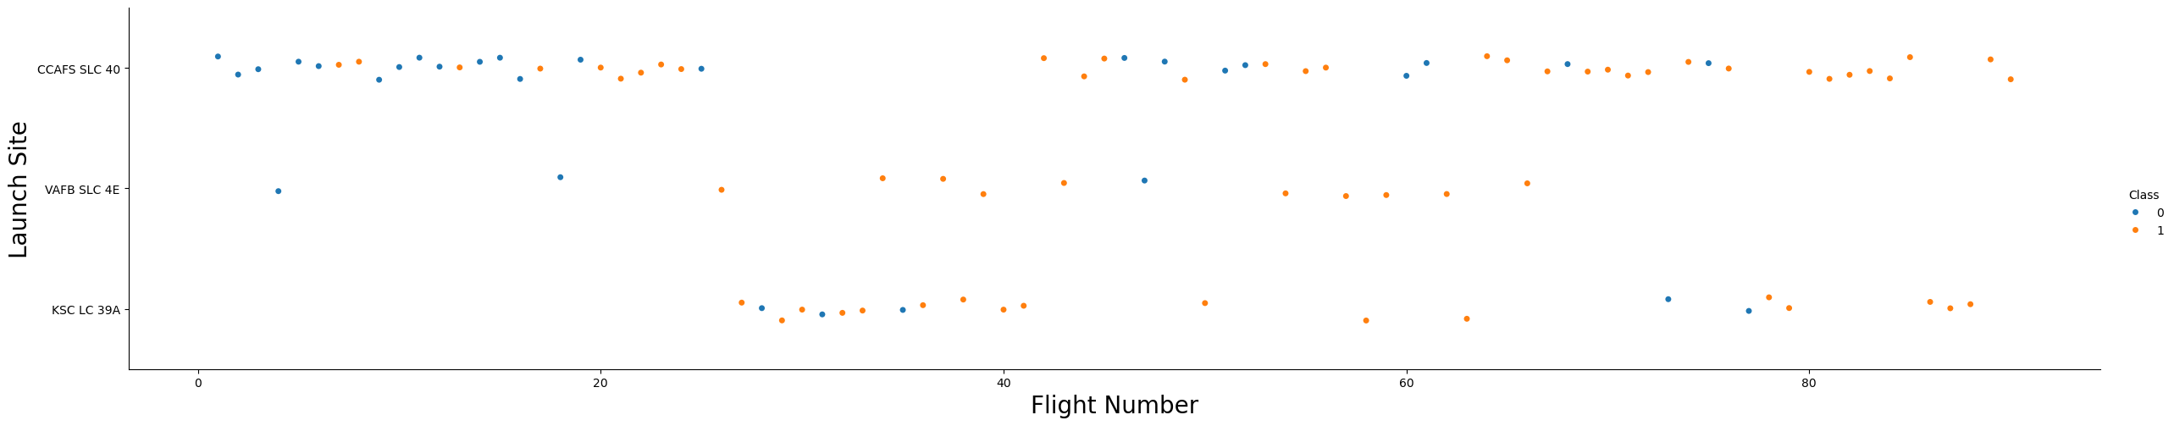
Flight Number vs. Launch Site
A plot of Flight Number vs. Launch Site, coloured by rocket recovery success or failure, shows that many of the failures occur for earlier flights

Slide 20
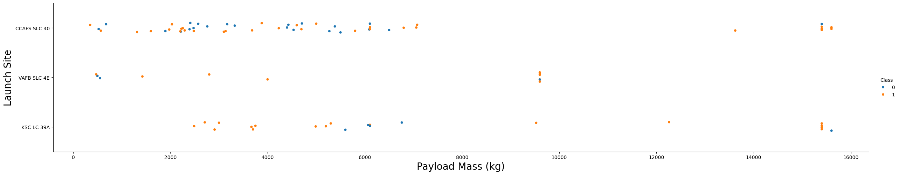
Payload vs. Launch Site
A plot of Payload vs. Launch Site shows higher recovery for greater payload mass

Slide 21
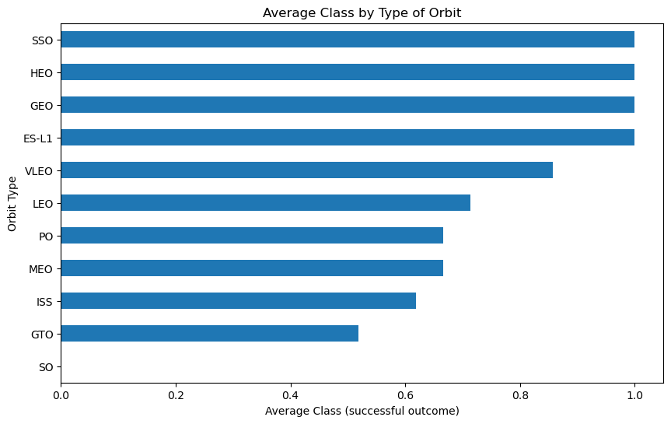
Success Rate vs. Orbit Type
From a bar chart displaying success rate with each orbit type, it’s clear that some orbits have more successful outcomes than others

Slide 22
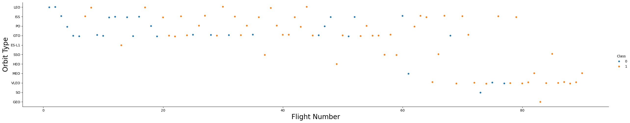
Flight Number vs. Orbit Type
A scatter point of Flight number vs. Orbit type shows once more that earlier flights have less success in recovering the booster
It also makes it clear that some “100%” success rates (on the previous plot) are a bit artificial, as some orbits include too few launches for this to be predictive

Slide 23
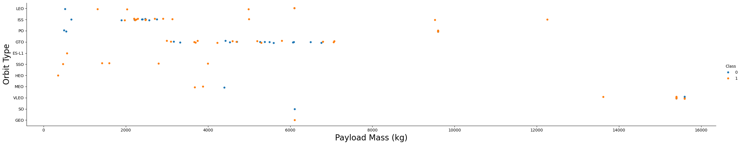
Payload vs. Orbit Type
A scatter point of Payload vs. Orbit type shows once more that heavier flights are more likely to have successful booster recovery
It also makes it clear that some “100%” success rates (on earlier plot) are a bit artificial, as some orbits include too few launches for this to be predictive

Slide 24
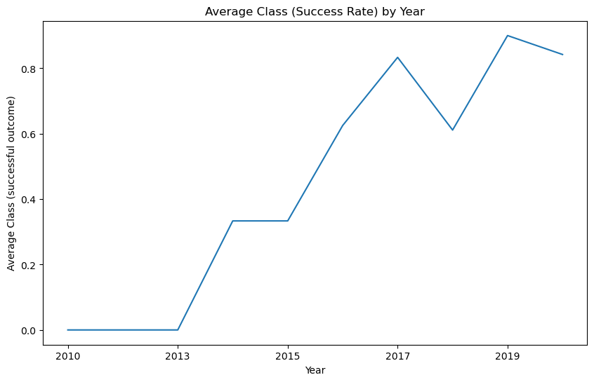
Launch Success Yearly Trend
Average Annual Success rate shows a steady trend upward, although with a small dip during 2018
We might investigate this further, as to what factors might have caused more failures in this period
2018 saw the transition from “Full Thrust” to “Block 5” booster, and some rework was needed before these were able to land successfully
Although missions were generally successful, some did not attempt to land the new booster

Slide 25
Launch Site Names
The launch-site names (unique) found in the data were:
Launch_Site
CCAFS LC-40
CCAFS SLC-40
KSC LC-39A
VAFB SLC-4E

Slide 26
Launch Site Names Beginning with 'CCA'
The first 5 records returned, for launch-site names beginning with ‘CCA’
It’s apparent that early flights used less powerful (v1) boosters, to Low Earth Orbit, and were not yet able to land successfully, maybe suggesting a degree of “trial running”
Date | Time (UTC) | Booster_Version | Launch_Site | Payload | PAYLOAD MASS (KG) | Orbit | Customer | Mission Outcome | Landing Outcome
2010-06-04 | 18:45:00 | F9 v1.0 B0003 | CCAFS LC-40 | Dragon Spacecraft Qualification Unit | 0 | LEO | SpaceX | Success | Failure (parachute)
2010-12-08 | 15:43:00 | F9 v1.0 B0004 | CCAFS LC-40 | Dragon demo flight C1, two CubeSats, barrel of Brouere cheese | 0 | LEO (ISS) | NASA (COTS) NRO | Success | Failure (parachute)
2012-05-22 | 7:44:00 | F9 v1.0 B0005 | CCAFS LC-40 | Dragon demo flight C2 | 525 | LEO (ISS) | NASA (COTS) | Success | No attempt
2012-10-08 | 0:35:00 | F9 v1.0 B0006 | CCAFS LC-40 | SpaceX CRS-1 | 500 | LEO (ISS) | NASA (CRS) | Success | No attempt
2013-03-01 | 15:10:00 | F9 v1.0 B0007 | CCAFS LC-40 | SpaceX CRS-2 | 677 | LEO (ISS) | NASA (CRS) | Success | No attempt

Slide 27
Total Payload Mass - for NASA
The total payload launched where NASA was the customer
total_payload_kg
45596

Slide 28
Average Payload Mass by F9 v1.1
The average payload mass carried by booster version F9 v1.1 is around 2.5 tonnes
Avg_payload_kg
2534.67

Slide 29
First Successful Ground Landing Date
The date of the first successful landing outcome on ground pad
Earliest_Ground_Pad
2015-12-22

Slide 30
Drone Ship Landings for Payloads 4000 - 6000
A list of the boosters used for successful drone ship landings, where payload mass was between 4000 and 6000 kg
Booster_Version
F9 FT B1021.2
F9 FT B1022
F9 FT B1026
F9 FT B1031.2

Slide 31
Mission counts by recovery success and failure
Counts of the successful and failed (overall) mission outcomes
Mission_outcome | nFlights
Failure | 1
Success | 100

Slide 32
Boosters Which Carried Maximum Payload
A list of the boosters which have carried the maximum payload mass
Booster_Version
F9 B5 B1048.4
F9 B5 B1048.5
F9 B5 B1049.4
F9 B5 B1049.5
F9 B5 B1049.7
F9 B5 B1051.3
F9 B5 B1051.4
F9 B5 B1051.6
F9 B5 B1056.4
F9 B5 B1058.3
F9 B5 B1060.2
F9 B5 B1060.3

Slide 33
2015 Launch Records
For drone-ship landing failures in 2015, list the month name, landing_outcome, booster version, and launch site name
monthName | Landing_Outcome | Booster_Version | Launch_Site
January | Failure (drone ship) | F9 v1.1 B1012 | CCAFS LC-40
April | Failure (drone ship) | F9 v1.1 B1015 | CCAFS LC-40

Slide 34
Rank Landing Outcomes 2010-06-04 to 2017-03-20
Rank the counts for each type of landing outcome (such as Failure (drone ship) or Success (ground pad)), in descending order
Examine records only between 2010-06-04 and 2017-03-20
landing_outcome | nOfType | MostFreq
No attempt | 10 | 1
Failure (drone ship) | 5 | 2
Success (drone ship) | 5 | 2
Controlled (ocean) | 3 | 4
Success (ground pad) | 3 | 4
Failure (parachute) | 2 | 6
Uncontrolled (ocean) | 2 | 6
Precluded (drone ship) | 1 | 8

Slide 35

Launch Site Proximity Analysis - Section
Section 3

Slide 36
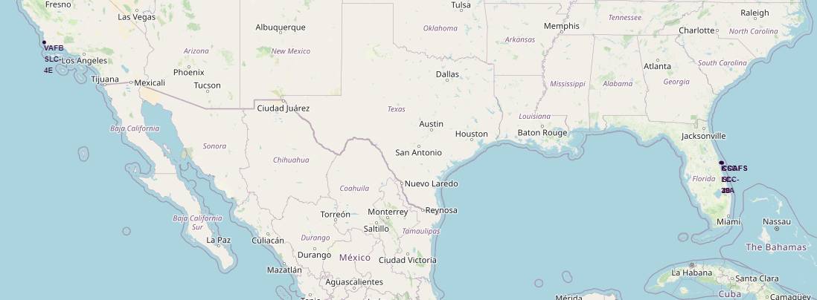
Launch Sites Map (zoom level USA) - Folium
Zoomed out to the lower USA, we can see where the sites are, but with little detail
DivIcon markers show permanent site labels, but 3 of these overlap in Florida

Slide 37
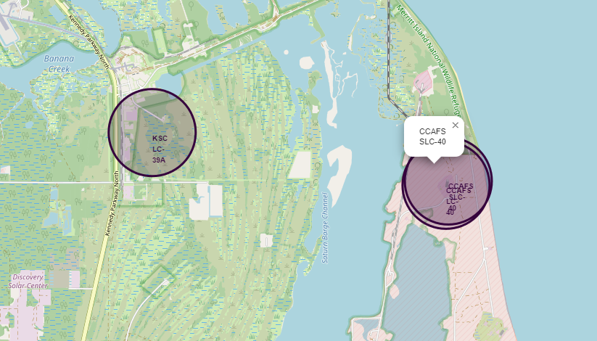
Launch Sites Map (zoom level Florida) - Folium
Zoomed in to a small area of Florida, we can see three sites (2 are overlapped)
Circle markers help locate the sites, and one has its popup displayed here
DivIcon markers provide permanent site label display

Slide 38
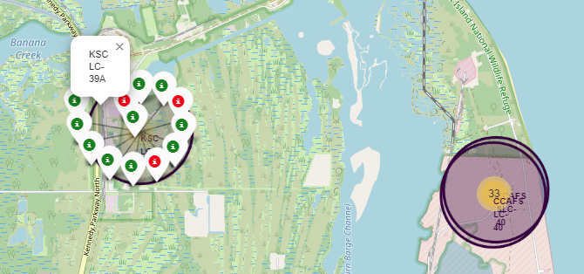
Launch Site Success Record - Folium
A “marker cluster” links groups of icons to a map reference
Markers with the same coordinates show as a yellow circle giving a count
Clicking within the circle zooms in to show individual icons
Individual (white) icons can be coloured by state – in this case to show recovery

Slide 39
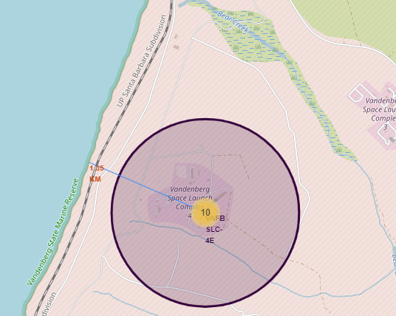
Mapping to Nearby Utilities - Folium
Maps can be further annotated with
Points of interest (such as nearest sea access)
Markers can be annotated with distances and not just names
Lines (PolyLine) to demonstrate the distances indicated on the marker
This site, within Vandenberg Air Force Base (VAFB) has few available services, with road and sea access both similar distances away (and NO close rail access)

Slide 40

Build a Dashboard with Plotly Dash - Section
Section 4

Slide 41
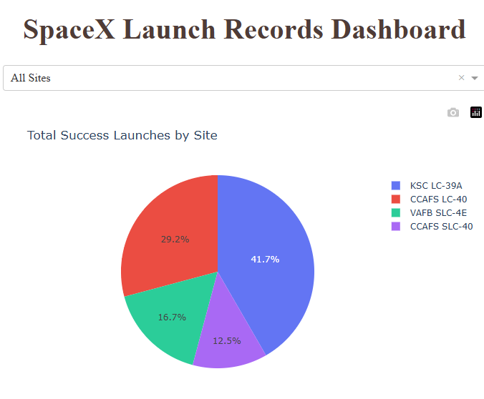
Total Success Launches by Site - Pie
With “All Sites” selected, the pie chart shows proportion by Site of successful rocket recoveries
Site KSC has the most successful recoveries, with 10 (as seen when hovering over the segment)
The maths for “success” works because the class value of 1 shows up, while the value 0 (failure) has no impact

Slide 42
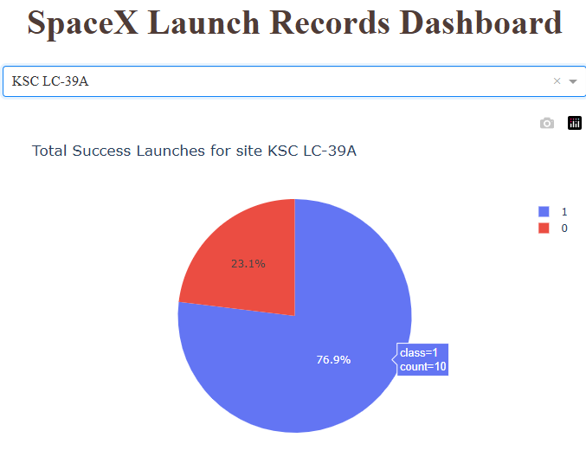
Success vs Failure for Site “KSC” - Pie
With a single site selected – here KSC, the most successful - the pie chart shows recovery success vs failure
Hovering over the segments shows 10 successes and 3 failures
The maths for comparing between categories needs a dataframe group-by step, producing counts for each category that can be plotted

Slide 43
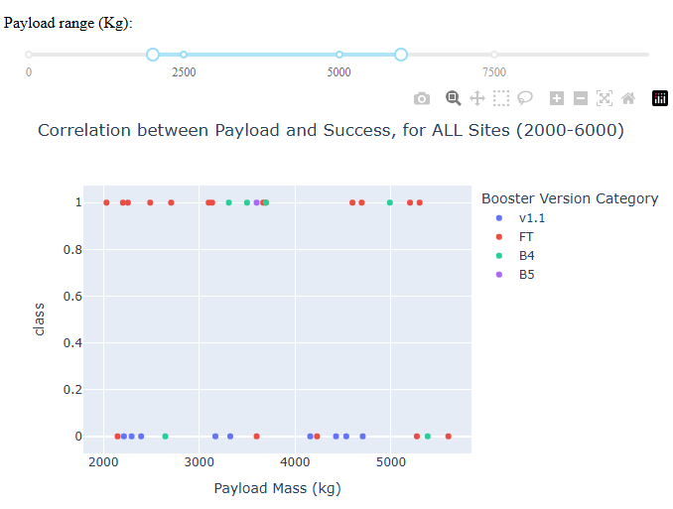
Success vs Payload, by Booster
The chart for Success vs Payload has a key to show which Booster was involved in each launch
we can see that FT and B4 are very common in successful launches
The limits of the Payload axis can be varied with a RangeSlider tool, allowing focus on part of the range
I added the range limits to the title as an exercise

Slide 44

Predictive Analysis (Classification) - Section
Section 5

Slide 45
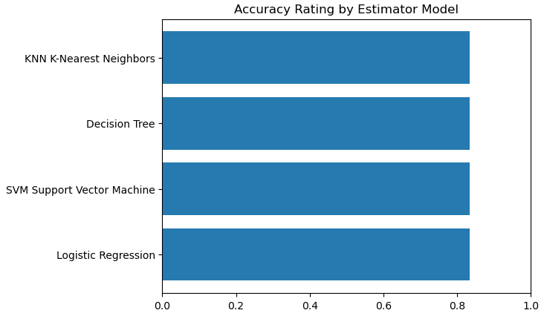
Classification Accuracy
All estimator models showed the same accuracy. There is nothing to distinguish between them
(All = 0.83333)

Slide 46
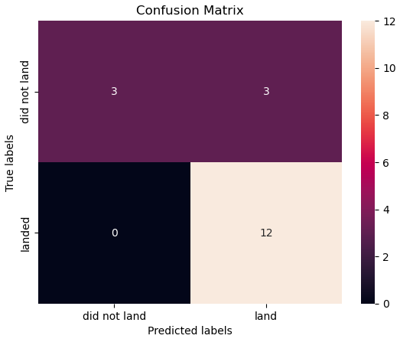
Confusion Matrix – Shared over 3 models
Three of the 4 models showed this same Confusion Matrix
12 successful landing predictions, and 3 successful predictions of failure-to-land
3 predictions of landing were false, as the true data shows landing failures
We are told that SpaceX sometimes “sacrifices” recovery due to other mission parameters
The ratio of 15 correct from 18 predictions gives 0.8333 prediction accuracy, under KNN, SVM and Logistic Regression models

Slide 47
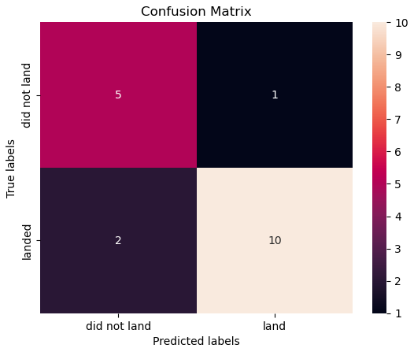
Confusion Matrix - Outlier
One of the 4 models showed this slightly different Confusion Matrix
The ratio of 15 correct from 18 predictions is the same, at 0.8333 prediction accuracy, for the Decision Tree model
While not a requirement, I examined alternate score methods for the model
Jaccard Index is 0.625, vs 0.5 for the other models
f1 Score is 0.836, vs 0.815 for the other models
While some scores are a little better for this model, the results are much worse on re-run, so an unstable model here!

Slide 48
Conclusions
It is clearly very practical to expect to be able to reuse the boosters. Evidence shows that this happens commonly since the relevant technology was introduced
Even where recovery was not made, there is evidence that this is not always a failure, as given by the outcome None/None which indicates that there was no intention to recover
The confusion matrices produced in Machine Learning all show a similar level of success in prediction, suggesting there is stability in that result
The yearly-trend plot shows that successful recovery of boosters is becoming consistently reliable – despite the minor dip in 2018

Slide 49
Appendix
No other relevant content was created during this project

Slide 50

Goodbye, and Thanks!

